Slide 1
Information economy: requisite infrastructure

Slide 2
Information economy
An information economy is a global economy based on combined data from products, prices, and customers throughout the world. This combined information makes it possible for consumers to see and purchase products in the global market. In an information economy, consumers have access to information about inventory and prices for products from multiple vendors.
Information Economics It is studied at the micro-level dealing with problems of information in terms of uncertainty, asymmetry of information between buyers and sellers in different types of markets. Such as Products market, Insurance market, Job market. Inadequate information may create a variety of problems.

Slide 3
Information economy
The components of information economy include
Information Workforce
Information Goods and Services
Information Machinery
Information Industry and Markets
Information Infrastructure

Slide 4
Information economy
Characteristics of Information Economics
Information Economics is sharable, not exchangeable and can be given away and retained at the same time
Is expandable and increase with use
Is compressible, able to be summarized and integrated, etc.
Is acquired at a definite measurable cost
Processes are definite value, depending upon its user which may be quantified and treated as an accountable asset
may vary in value over time in an entirely unpredictable way
has a 'consumption rate' which may be quantified
is a amenable to the user of cost accounting techniques and is a source of both economic and political power.

Slide 5
Information economy
basic typology of information activities
Education
Research & Development
Media of Communication
Information Machinery
Information services

Slide 6
Information economy
basic typology of information activities
Education
Research & Development
Media of Communication
Information Machinery
Information services

Slide 7
Information economy
Information Workforce
Information workforce no longer it is restricted to library and information professionals.
It includes several other groups of information oriented occupations.

Slide 8
Information economy Requisite infrastructure
Economic. According to the business dictionary, economic infrastructure can be defined as "internal facilities of a country that make business activity possible, such as communication, transportation and distribution networks, financial institutions and markets, and energy supply systems".

Slide 9
Regulatory regime
A system of regulations and the means to enforce them, usually established by a government to regulate a specific activity.
A regulatory regime represents any type of authority which can operate at either industrial, national or international levels and which can influence, direct, limit or prohibit any activity undertaken by any stakeholder operating in the mobile telecommunications industry (Yoo, Lyytinen, & Yang, 2005). Learn more in: Shaping Regulation in the Australian Mobile Industry

Slide 10
Regulatory regime
Accessing Laws and Regulations
Transparency of Rulemaking
Public Consultations
Challenging Regulations

Slide 11
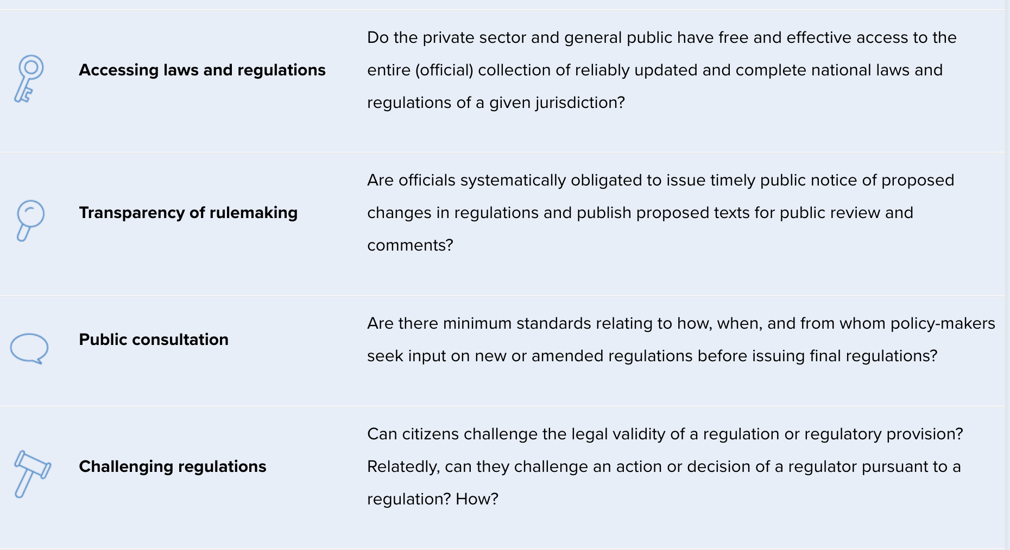
Regulatory regime

Slide 12
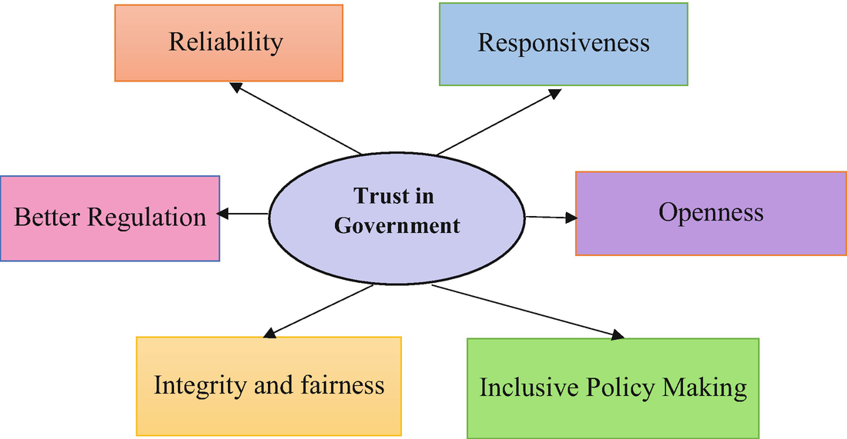
Trust - governance and accountability

Slide 13
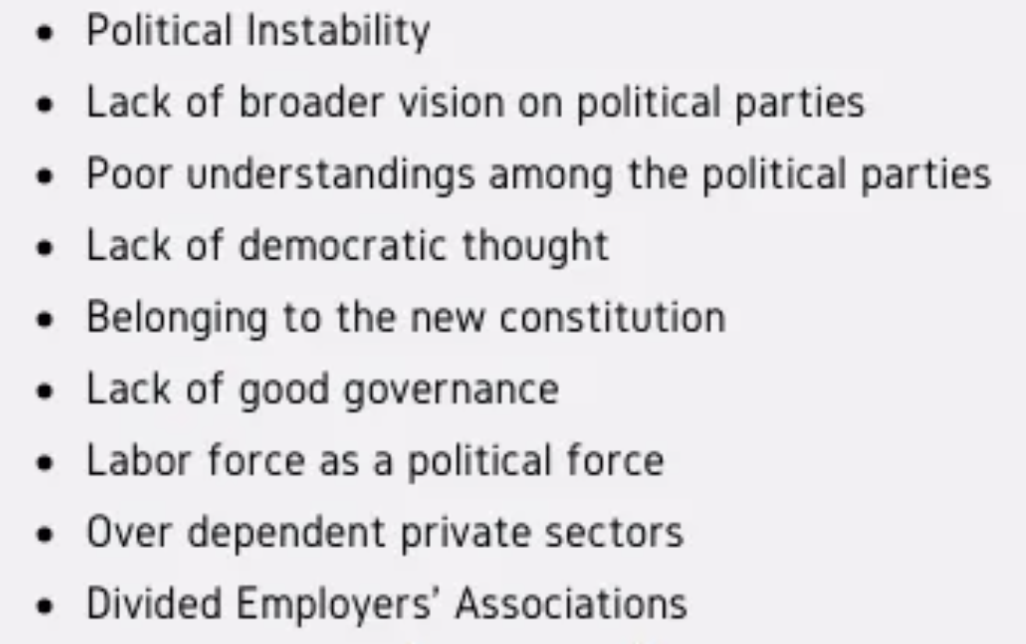
Operational issues

